Slide 1


Effective Online Tool for Mathematics Communication
Sohee Kang and Sotirios Damouras
Department of Computer and Mathematical Sciences, University of Toronto Scarborough

Slide 2

Outline
Mathematical Communication
Mathematical Classroom Collaborator (MC2)
MC2 Action in Statistics courses
Real-time Demonstration

Slide 3
Why is Mathematical Communication Hard?
It requires a facilitating medium (chalkboard, paper, sand, ...)

Slide 4
Text-Based Expression Entry

Slide 5
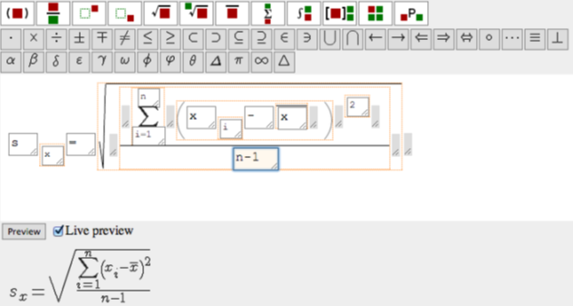
Place your screenshot here
Math Input Alternative: Structure-Based Expression Input

Slide 6
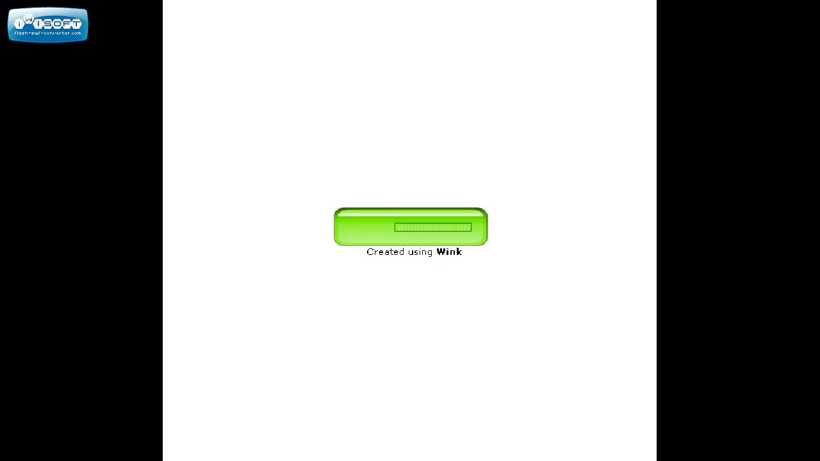
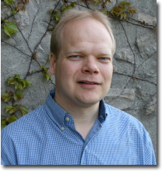
Place your screenshot here
Diagram Editor Model by Pollanen et al (2014)

Slide 7
Mathematics Classroom Collaborator (MC²)
Directions:
A tool allowing for anonymous office hours in quantitative courses
A tool allowing students to collaborate with each other in discussions using anonymously
A tool allowing students in class to anonymously send questions to their professor in class

Slide 8
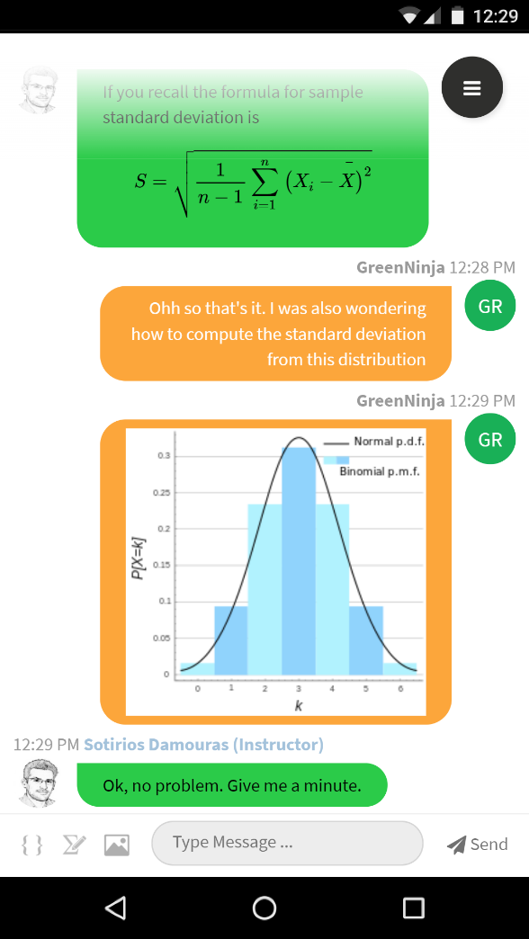
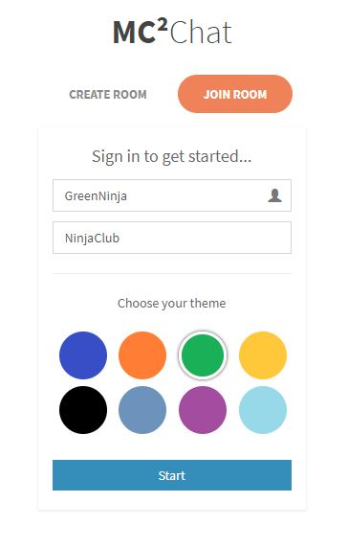
Place your screenshot here
Mathematics Classroom Collaborator (MC2)

Slide 9
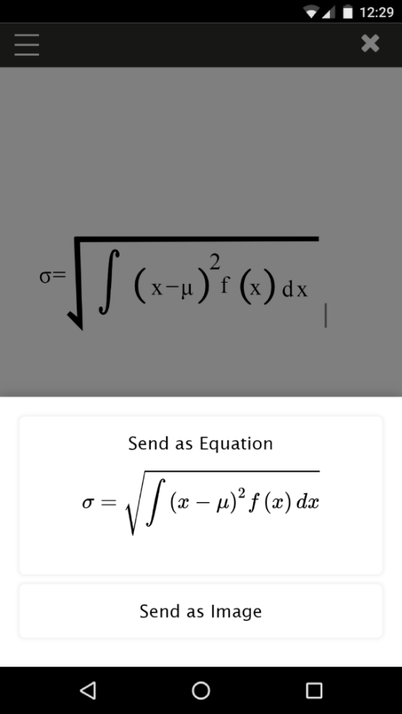
Place your screenshot here
Mathematics Classroom Collaborator (MC2)

Slide 10
MC² Action In Classroom
STAB52
Introduction to Probability (n=386)
Three sections taught by the same instructor
MC² was used in weekly in-class group work sessions (2 hours)
STAB27
Statistics II (n=80)
MC² was used in weekly in-class group work sessions (1 hour) after the midterm and online office hours before the final exam.

Slide 11
STAB52 (Introduction to Probability)
Semi-inverted classroom format: each week, two hours of lectures and two hours of work-sheet time.
During the weeks when MC² was used in any given section, only the instructor answered student questions submitted through the tool, while the TAs provided face-to-face assistance.
Students could post questions anonymously, and their questions and answers were visible to everyone.

Slide 12
Worksheet Marks Distribution

Slide 13
ANOVA Result
All nuisance variables (LECTURE, WS, CGPA) are highly significant.
The overall effect (across all sections) of MC2 was not statistically significant, but it differs significantly across sections at the 5% level
Section 3 (added later) received the greater benefit from MC².

Slide 14
MC² Action In STAB27
STAB27 Class composition:
Gender - 49% Female, 46% Male, and 5% Undefined
Legal Status - 66% Domestic and 34% International Students.
MC² was used after the midterm – use midterm as a control.
Define a variable:
Improve = Scale(Final Exam) – Scale(Midterm)
Diff = 1 : (Improve > 0) – Improved Performance
Diff = 0: (Improve ≤ 0) – Not Improved Performance

Slide 15
MC² Action In STAB27
MC² contributed to build more inclusive classroom? – More engagement of Female or International Students?
Logistic regression with the response variable Y:
Y = 1 : Use MC² at least one time
Y = 0 : No use of MC²
Coefficients:
Estimate Std. Error z value Pr(>|z|)
(Intercept) 0.04676 0.80561 0.058 0.9537
Diff 0.89762 0.53386 1.681 0.0927 .
GENDERM -1.31440 0.56575 -2.323 0.0202 *
GENDERU 0.18227 1.21410 0.150 0.8807
LEG_STATUSInternational -0.50350 0.58184 -0.865 0.3868
YEAR_OF_STUDY -0.13970 0.26034 -0.537 0.5915

Slide 16
MC² Action In STAB27
Interpretations:
After we control for other variables, there is a statistically significant (P-value < 0.05) engagement difference between Male and Female. Females have a higher rate of using MC² compared to Males.
After we control for other variables, there is a marginally significant (P-value < 0.1) engagement difference. Improved course performance group has a higher rate of using MC² compared to Non-improved Group

Slide 17
MC² Action In Online Office Hours
Before the final exam, the instructor offered two types of extended office hours
Type of Office Hours | Number of Students
Face-to-Face (3 hrs) | 4
Face-to-Face (1 hr) | 3
MC2 Office Hour (1 hr) | 14 (26 logged in)
MC2 Office Hour (1 hr) | 13 (27 logged in)

Slide 18
Reference
Gozli D, Pollanen M, & Reynolds M (2009) The characteristics of writing environments for mathematics: behavioral consequences and implications for software design and usability. Lecture Notes in Artificial Intelligence 5625:310-324.
Hooper, J., Pollanen, M., & Teismann, H. (2006). Effective Online Office Hours in the Mathematical Sciences, Journal of Online Learning and Teaching, 2(3), 187-194.
Helvie-Mason, L. (2012). Office Hours: `There's an App for that?!' Student perceptions of faculty channels for out-of-class communication, International Journal of Instructional Technology and Distance Learning, Vol. 9.
Nadler, M.K. & Nadler, L.B. (2000). Out-of-class communications between faculty and students: A faculty perspective. Communication Studies, 51(2), 176-188.
Padovini, L. & Solmi, R. (2004). An Investigation on the Dynamics of Direct- Manipulation Editors for Mathematics. Lecture Notes in Computer Science, 3119, 302-316.
Perry, A.P. (2004). Decreasing math anxiety in college students. College Student Journal, 38.
Pollanen, M. (2006). Interactive Web-Based Mathematics Communication. Journal of Online Mathematics and its Applications, vol 6.
Pollanen, M., Wisniewski, T., & Yu, X. (2007), XPress: A Novice Interface for the Real-Time Communication of Mathematical Expressions. Proceedings of MathUI 2007, Linz, Austria, June 2007
Pollanen, M., Kang, S., Cater, B., Chen, Y., Lee, K. (2017). MC2: Mathematics Classroom Collaborator. Proceedings of the Workshop on Mathematical User Interfaces, Edinburgh, UK

Slide 19
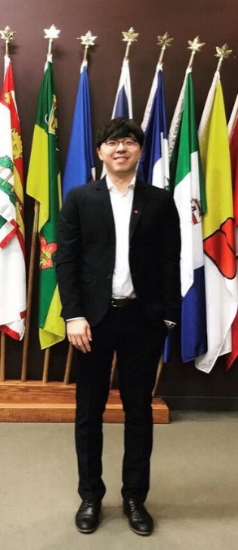
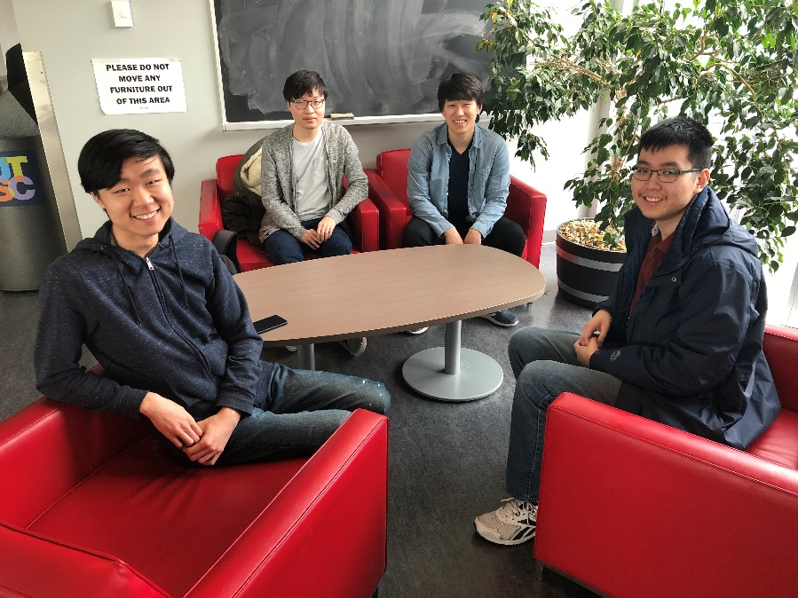

THANKS!
Danny Yu
Wannie Chen, Ryan Lee, Jun Zheng, Daniel Hugh

